Slide 1

Combinational Logic Gates in CMOS
By
Dr.Rohit Lorenzo
Assistant Professor Sr. Grade -1
School of Electronics Engineering (SENSE)

Slide 2
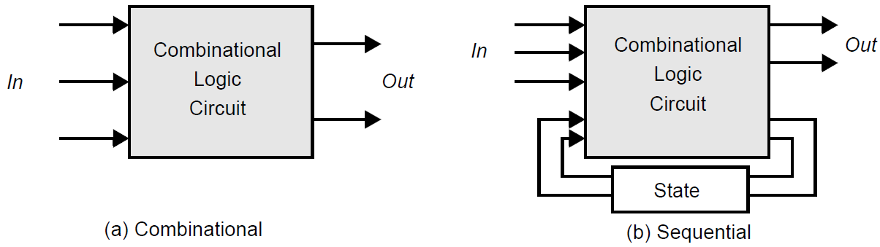
Introduction
The focus is on combinational logic (or non-regenerative) circuits; this is, circuits that have the property that at any point in time, the output of the circuit is related to its current input signals.
This is in contrast to another class of circuits, known as sequential or regenerative, for which the output is not only a function of the current input data, but also of previous values of the input signals. This is accomplished by connecting one or more outputs intentionally back to some inputs. Consequently, the circuit “remembers” past events and has a sense of history.

Slide 3
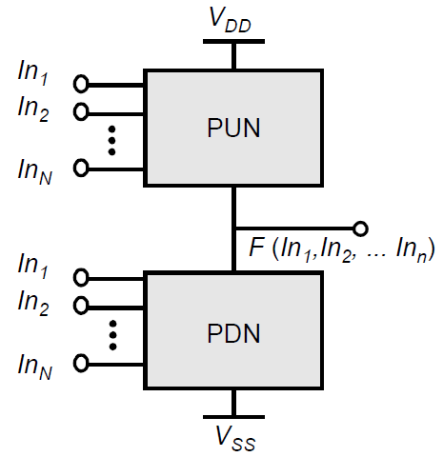
Static and Dynamic Logic Design
Static Design - At every point of time each gate output is either connected
to V_{DD} or V_{SS} via a low resistance path. The static CMOS style is really an
extension of the static CMOS inverter to multiple inputs.
Dynamic Design - This relies on temporary storage of signal values
on the capacitance of high-impedance circuit nodes.
Complementary CMOS - A static CMOS gate is a combination of two
networks, called the pull-up network (PUN) and the pull-down network (PDN).
The function of the PUN is to provide a connection between the output
and V_{DD .} Similarly, the function of the PDN is to connect the output to V_{SS}.

Slide 4
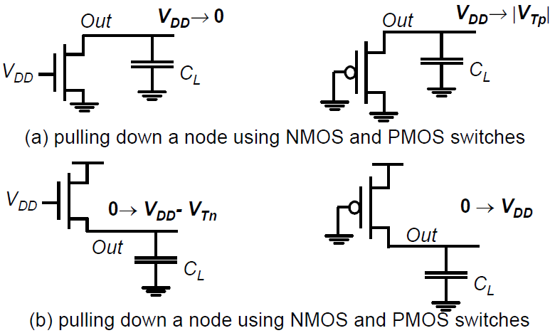
Choice of Network
The PDN is constructed using NMOS devices, while PMOS transistors are used in the PUN. The primary reason for this choice is that NMOS transistors produce “strong zeros,” and PMOS devices generate “strong ones”. To illustrate this, consider the examples shown in Figure.

Slide 5


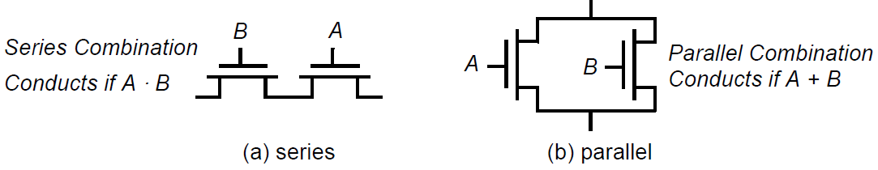
Logic Rules
A set of construction rules can be derived to construct logic functions NMOS devices connected in series corresponds to an AND function. With all the inputs high, the series combination conducts and the value at one end of the chain is transferred to the other end.
Similarly, NMOS transistors connected in parallel represent an OR function. A conducting path exists between the output and input terminal if at least one of the inputs is high.
A series connection of PMOS conducts if both inputs are low, representing a NOR function , while PMOS transistors in parallel implement a NAND ( ) .
.

Slide 6
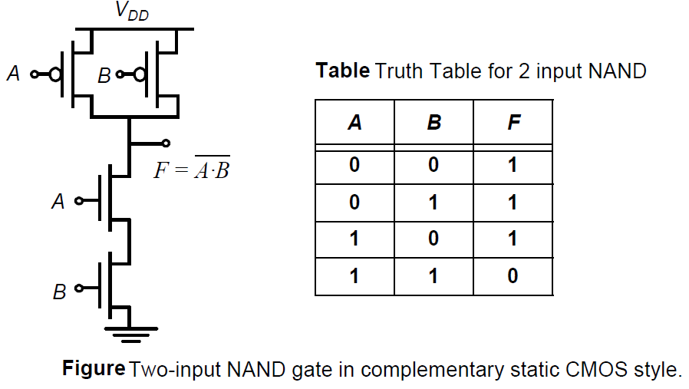
Problem - Two-input NAND Gate

Slide 7
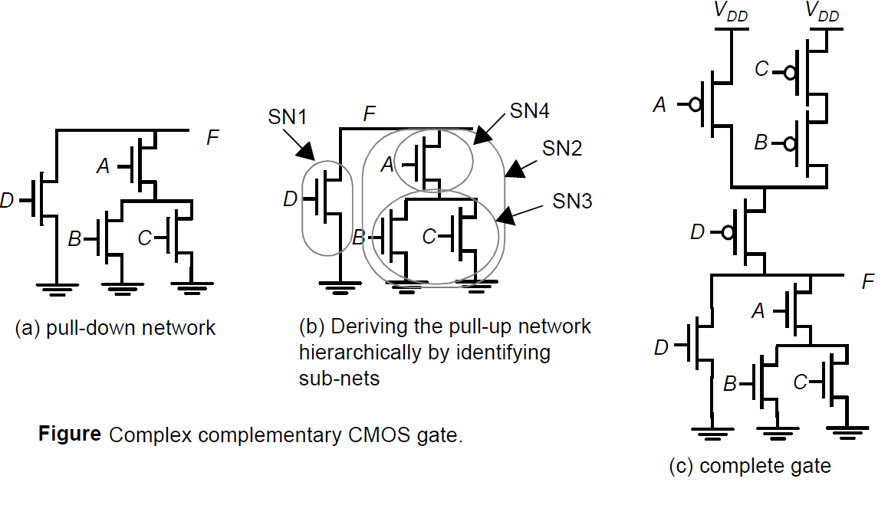

Synthesis of complex CMOS Gate

Slide 8
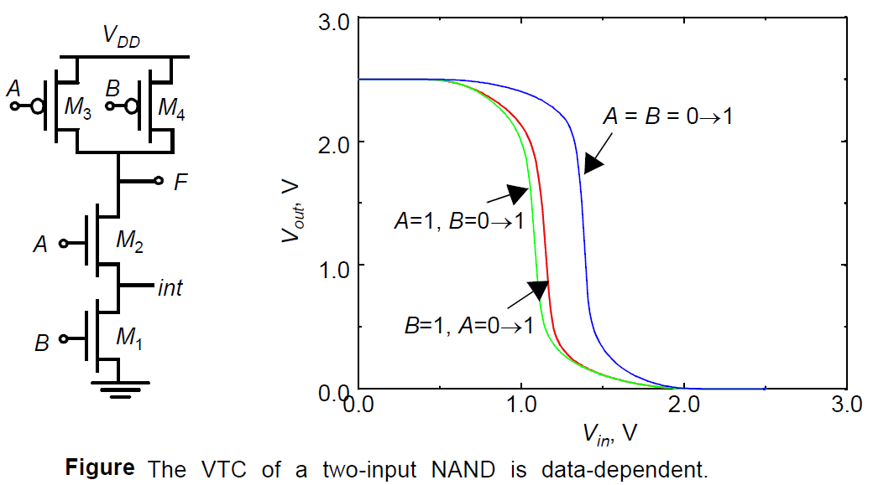
Static Properties of Complementary CMOS Gates
The analysis of the DC voltage transfer characteristics and the noise margins is more complicated then for
the inverter, as these parameters depend upon the data input patterns applied to gate.
Consider three possible inputs in NAND gate. Consequently, voltage transfer curves display significant
differences . The large variation between case (a) and the others (b & c) is explained by the fact. The VTC
is shifted to the left as a result of the weaker PUN.
The difference between (b) and (c) results
mainly from the state of the internal node
int between the two NMOS devices.
The NMOS devices to turn on, both gate
-to source voltages must be above V_{Tn}
with V_{GS2} = V_{A}-V_{DS1} and V_{GS1} = V_{B}
The threshold voltage of M₂ will be higher
than M₁ due to body effect .

Slide 9
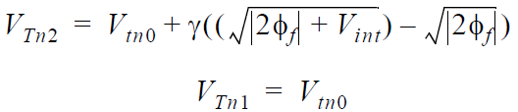
continue…..
The threshold voltages of the two devices are given by
For case (b), M₃ is turned off, and the gate voltage of M₂ is set to V_{DD}. Since the drive on M₂ is large,this
resistance is small and has only a small effect on the voltage transfer characteristics. In case (c), transistor
M1 acts as a resistor, causing body effect in M2. The overall impact is quite small as seen from the plot.
There are some conclusion from above analysis
Propagation delay is input dependent.
Noise margin is input dependent
PUN is stronger means NM_{H} is stronger.
PDN is stronger means NM_{L} is stronger.

Slide 10
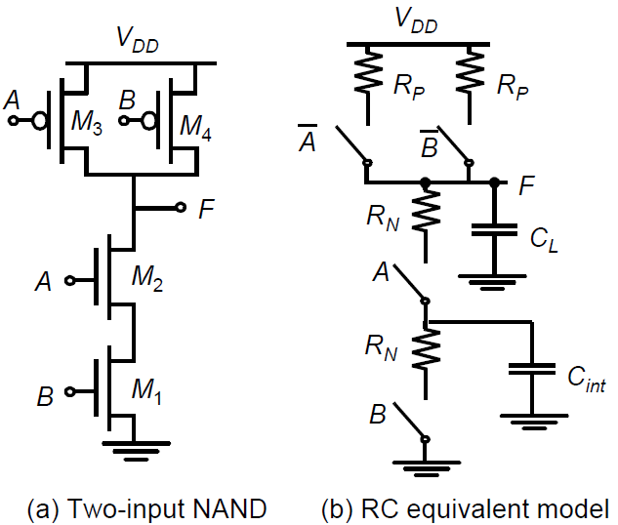
Propagation Delay of Complementary CMOS Gates
The delay can be computed by considering each transistor is modeled as a resistor in series with an ideal switch. The logic is transformed into an equivalent RC network that includes the effect of internal node capacitances. The propagation delay depends upon the input patterns.
If both inputs are driven low, the two PMOS devices are ON. The delay in this case is 0.69× (R_{p}/2) ×C_{L}, since the two resistors are in parallel. The worst case occur when only one device is ON - 0.69× R_{p} ×C_{L}.
The output is discharged only if both A and B are switched high, and
the delay is given by 0.69 × 2R_{N} ×C_{L}. In other words, adding devices in
series slows down the circuit, and devices must be made wider to avoid a
performance penalty.

Slide 11
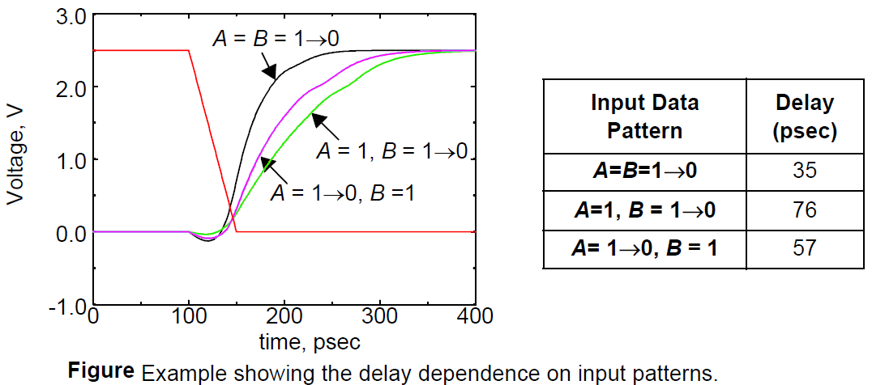
Delay dependence on input patterns
As expected, the case where both inputs transition go low (A = B =1 0) results in a smaller delay, compared to the case where only one input is driven low.
Notice that the worst-case low-to-high delay depends upon which input (A or B) goes low. For the case that B = 1 and A transitions from 1 0, the pull-up PMOS device only has to charge up the output node capacitance since M2 is turned off.
On the other hand, for the case where A=1 and B transitions from 1 0, the pull-up PMOS device has to charge up the sum of the output and the internal node capacitances, which slows down the transition

Slide 12
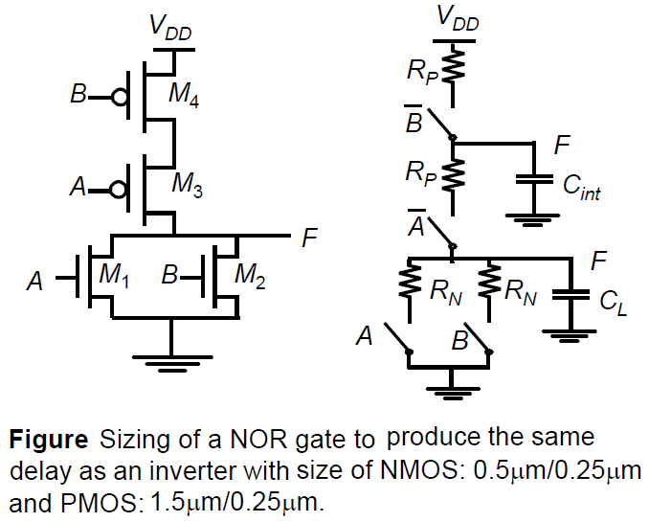
CMOS implementation of NOR gate
In case of NOR gate output of the network is high if and only if both inputs A and B are low. The worst-case pull-down transition happens when only one of the NMOS devices turns ON (if either A or B is high).
Assume that the goal is to size the NOR gate such that it has approximately the same delay as an inverter with the following device sizes, NMOS 0.5μm/0.25μm and PMOS 1.5μm/0.25μm.
For the output to be pulled high, both devices must be turned on
However, in more complex logic gates that have large
fan-in, the internal node capacitances can become
significant

Slide 13
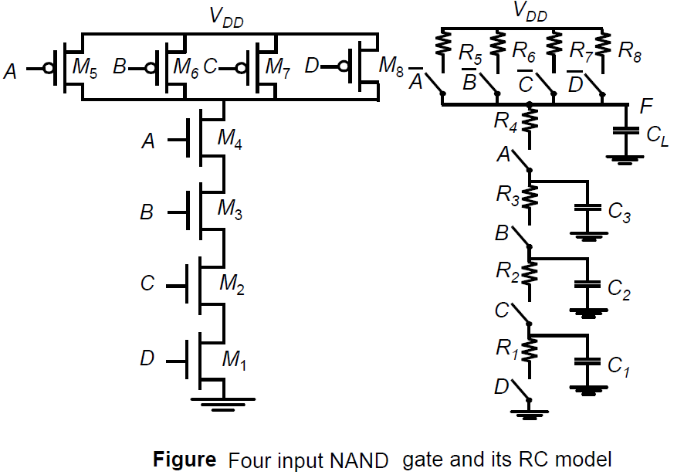
Continue….
The switching threshold, V_{M}, is defined as the point where V_{in} = V_{out}. Its value can be obtained graphically from the intersection of the VTC with the line given by V_{in} = V_{out} . In this region, both PMOS and NMOS are always saturated.
Consider a 4-input NAND gate as shown in Figure which shows the equivalent RC model of the gate, including the internal node capacitances.
The delay analysis for such a circuit involves
Solving distributed RC networks.
Consider the pull-down delay of the circuit.
The output is discharged when all inputs are
driven high.

Slide 14
continue…….
The propagation delay can be computed using the Elmore delay model and is approximated as:
_{……..(1)}
Assuming that all NMOS devices have an equal size
………(2)

Slide 15
Problems in CMOS
complementary CMOS is a very robust and simple approach for implementing logic gates.
First, the number of transistors required to implement an N fan-in gate is 2N. This can result in significant implementation area.
The large number of transistors (2N) increases the overall capacitance of the gate.
Propagation delay of the gates deteriorate as a function of fan-in.
The series connection of the transistor in either PUN or PDN network causes an additional slowdown.
Therefore the delay becomes a quadratic function of fan-in.
For an N-input NAND gate, the output capacitance increases linearly with the fan-in since the number of PMOS devices connected to the output node increases linearly with the fan-in. It also includes series connection of transistor because the effective (dis)charging resistance is increased. So the overall high-to-low delay can increase in a quadratic fashion.

Slide 16
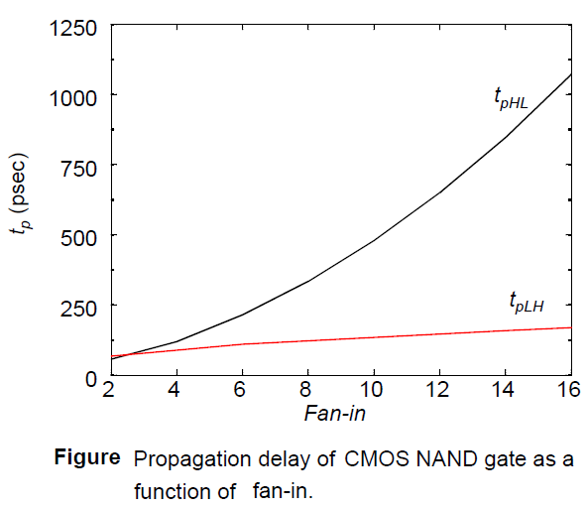
Propagation delay as a function of fan-in
The t_{pLH} increases linearly due to the linearly-increasing value of the output capacitance.
The simultaneous increase in the pull-down resistance and the load capacitance results in an approximately quadratic relationship for t_{pHL}.

Slide 17
Design Techniques for large Fan-in
Several approaches may be used to reduce delays in large fan-in circuits.
Transistor Sizing -
The most obvious solution is to increase the overall transistor size. This lowers the resistance of devices in series and lowers the time constant. However, increasing the transistor size, results in larger parasitic capacitors, which do not only affect the propagation delay of the gate in question. but also present a larger load to the preceding gate.
This technique should, therefore, be used with caution. If the load capacitance is dominated by the intrinsic capacitance of the gate, widening the device only creates a “self-loading” effect, and the propagation delay is unaffected.

Slide 18
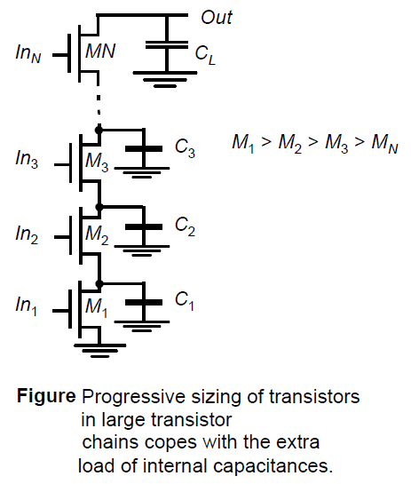
Progressive Transistor Sizing
An alternate approach to uniform sizing is to use progressive transistor sizing –
Referring equation 1 we see that the resistance of M1 (R1) appears N times (4 times) in the delay equation. the resistance of M2 (R2) appears N-1 times (3 times), etc.
From the equation, it is clear that R1 should be made
the smallest, R2 the next smallest, etc.
Consequently, a progressive scaling of the transistors
is beneficial: M₁>M₂>M₃>M_{N}.
Basically, in this approach, the important resistance is
reduced while reducing capacitance.

Slide 19
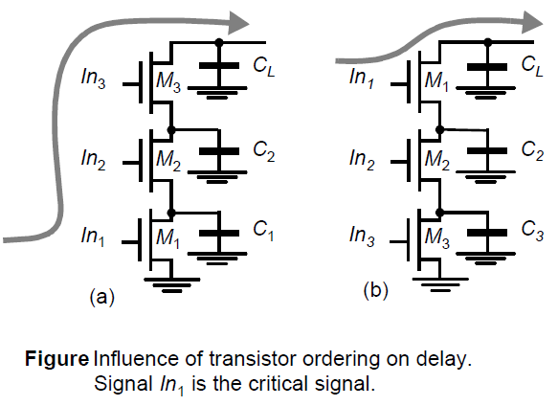
Input Re-Ordering
An input signal to a gate is called critical if it is the last signal of all inputs to assume a stable value. The path through the logic which determines the ultimate speed of the structure is called the critical path.
Putting the critical-path transistors closer to the output of the gate can result in a speedup. Assume also that C_{L} is initially charged high. In case (a), no path to GND exists until M₁ is turned ON.
The delay between the arrival of In1 and the output is therefore determined by the time it takes to discharge C_{L}, C₁ and C₂.
In the second case, C₁ and C₂ are already discharged when
In1 changes. Only C_{L} still has to be discharged, resulting in
a smaller delay.

Slide 20
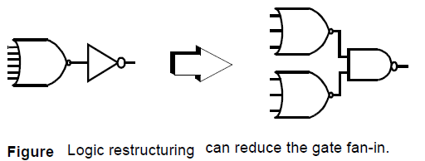
Logic Restructuring
Manipulating the logic equations can reduce the fan-in requirements and hence reduce the gate delay as shown in figure.
It is advisable to have symmetric function to derive the signal at proper time.
The quadratic dependency of the gate delay on fan-in makes the six-input NOR gate extremely slow.
Partitioning the NOR-gate into two three input gates results in a significant speed-up, which offsets by far the extra delay.

Slide 21



Power Consumption in CMOS Logic Gates
The dynamic power dissipation is given by
…….. (3)
Here is called the switching activity, which is having two components .
1- A static component that is only a function of the topology of the logic network.
2- Dynamic one that results from the timing behavior of the circuit—the latter factor is also called glitching.
The probability P₀ that the output will be in the zero state in one cycle, multiplied by the probability P₁
that the output will be in the one state in the next cycle
…….. (4)

Slide 22

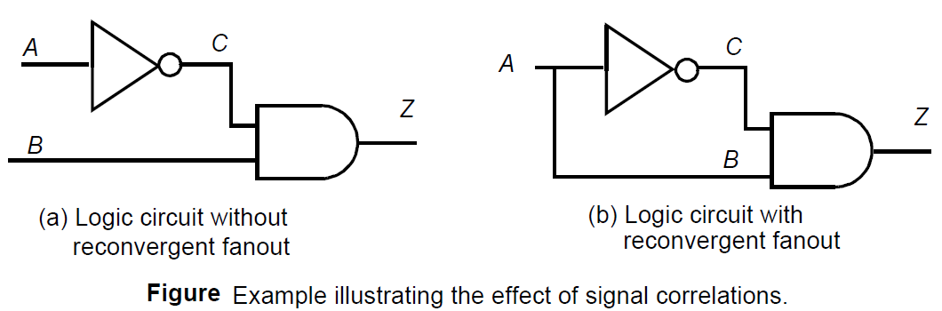
Inter-signal Correlations
The probability that the node Z undergoes a power consuming transition is then determined using the AND-gate expression.
The first approach has two major limitation (1) it does not deal with circuits with feedback as found in sequential circuits (2) it assumes that the signal probabilities at the input of each gate are independent.
If a dependency between the two exists a conditional probability has to be employed, such as
……(3)

Slide 23
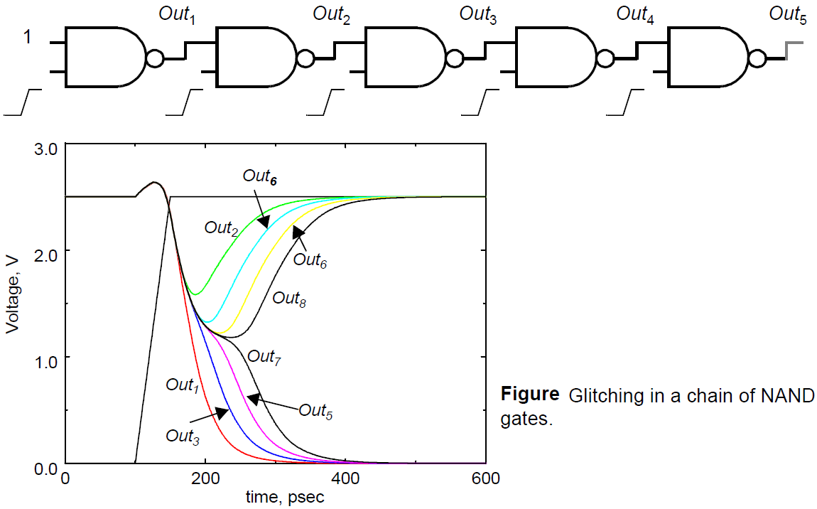
Dynamic or Glitching Transitions
The finite propagation delay from one logic block to the next can cause spurious transitions, called glitches, critical races, or dynamic hazards.
We can see in the example for this particular transition, all the odd bits must transition to 0 while the even bits remain at the value of 1. Due to the finite propagation delay, the higher order even outputs start to discharge and the voltage drops.
Glitches contribute significantly to the power
dissipation.
Long chains of gates often occur in important structures such as adders
and multipliers and the glitching component
can easily dominate the overall power
Consumption.

Slide 24
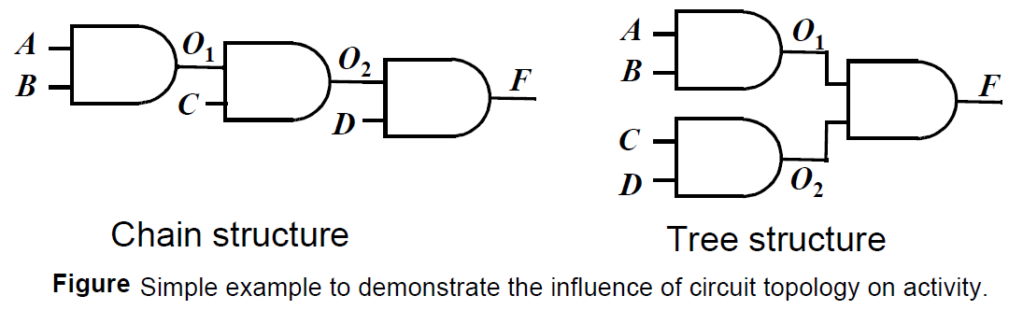
Design Techniques to Reduce Switching Activity
Logic Restructuring
Changing the topology of a logic network may reduce its power dissipation. Consider for instance two alternate implementations of F = A · B · C · D.
In this example the tree topology will have lower (no) glitching activity since the signal paths are balanced to all the gates.0

Slide 25
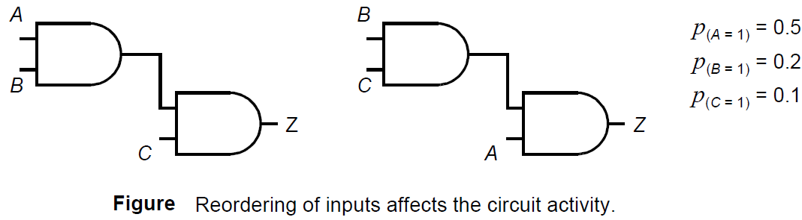
Input ordering
Consider the two static logic circuits of Figure. Both the circuits implement identical logic functionality
and have equal activity at the output node.
The difference is in the activity at the intermediate node. In the first circuit, this activity equals (1 - 0.5 × 0.2) (0.5 × 0.2) = 0.09.
In the second case, the probability that a 0 1 transition occurs equals (1 – 0.2 × 0.1) (0.2 × 0.1) = 0.0196.

Slide 26
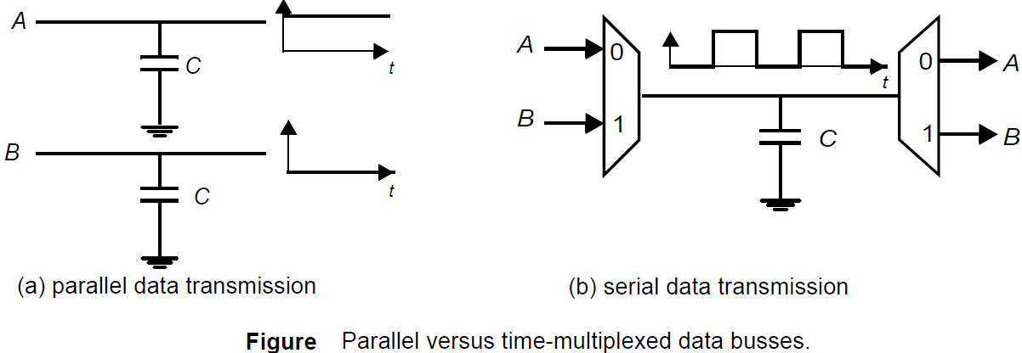
Time-multiplexing resources
Time-multiplexing a single hardware resource—such as a logic unit or a bus—over a number functions is an often used technique to minimize the implementation area. Unfortunately, the minimum area solution does not always result in the lowest switching activity.
The degree of time-multiplexing should not affect the switched capacitance, since the time-multiplexed solution has half the capacitance switched.

Slide 27
Continue……
However if the data signals have some distinct properties (called temporal correlation),the power dissipation of the time-multiplexed solution can be significantly higher.
Suppose, for instance, that A is always (or mostly) 1 and B is (mostly) 0. In the parallel solution, the switched capacitance is very low since there are very few transitions on the data bits. However, in the time-multiplexed solution, the bus toggles between 0 and 1.

Slide 28
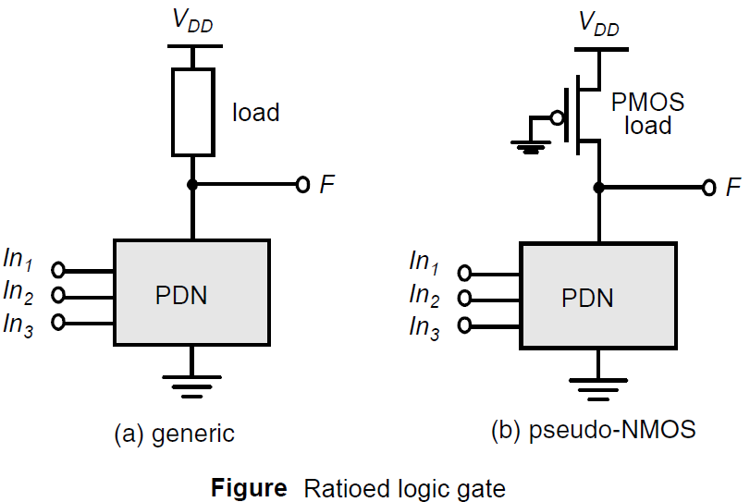
Ratioed Logic
Ratioed logic is used to reduce the number of transistors count but at the cost of extra power dissipation and reduced robustness.
In ratioed logic, the entire PUN is replaced with a single unconditional load device.
The nominal high voltage (V_{OH}) is V_{DD} but the nominal low voltage (V_{OL}) is not zero which results a static power dissipation.
This also reduced the noise margin.
Since, the output voltage depends on the
sizes of the transistor so it is called ratioed logic.

Slide 29
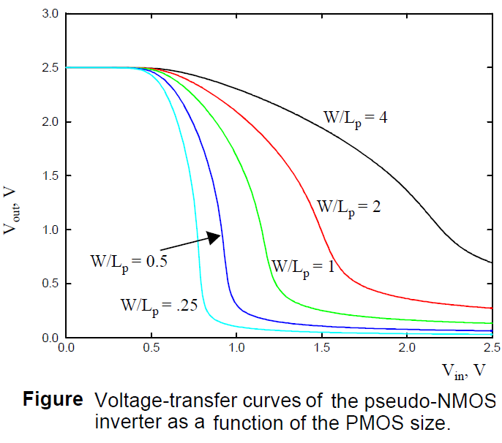
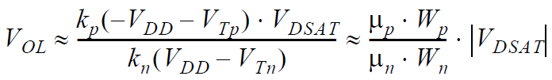
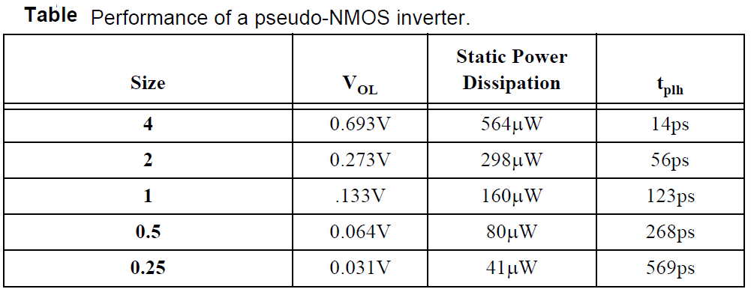
Continue…..
The sizing of the load device relative to the pull-down devices can be used to trade-off parameters such a noise margin, propagation delay and power dissipation.
Since the voltage swing on the output and the overall functionality of the gate depends upon the ratio between the NMOS and PMOS sizes, the circuit is called ratioed.

Slide 30
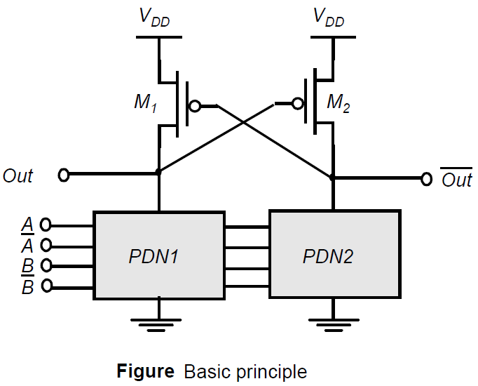

Differential Cascode Voltage Switch Logic (DCVSL)
It is possible to create a ratioed logic style that completely eliminates static currents and provides rail-to-rail swing. Such a gate combines two concepts: differential logic and positive feedback.
A differential gate requires that each input is provided in complementary format, and produces complementary outputs. A example of such a logic family, called Differential Cascode Voltage Switch Logic (or DCVSL) is presented in figure.
when PDN1 conducts, PDN2 is off, and when
PDN1 is off, PDN2 conducts.
Assume now that, for a given set of inputs, PDN1
conducts while PDN2 does not, and that Out
and are initially high and low, respectively.
Turning on PDN1, causes Out to be pulled down,
although there is still a fight between M1 and
PDN1.

Slide 31
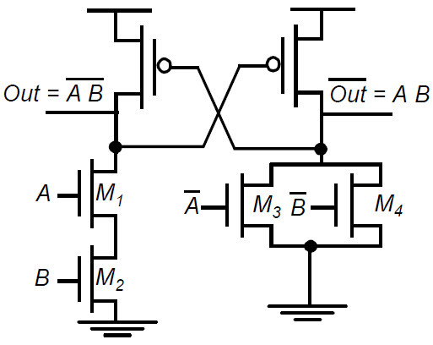
Continue….
At one point M2 turns on and starts charging Out to V_{DD}—eventually turning off M1. This in turn enables Out to discharge all the way to GND.
The resulting circuit exhibits a rail-to-rail swing, and the static power dissipation is eliminated.
The circuit is still ratioed since the sizing of the PMOS devices relative to the pull-down devices is critical. In addition to the problem of increase complexity in design. This circuit style still has a power-dissipation problem.

Slide 32
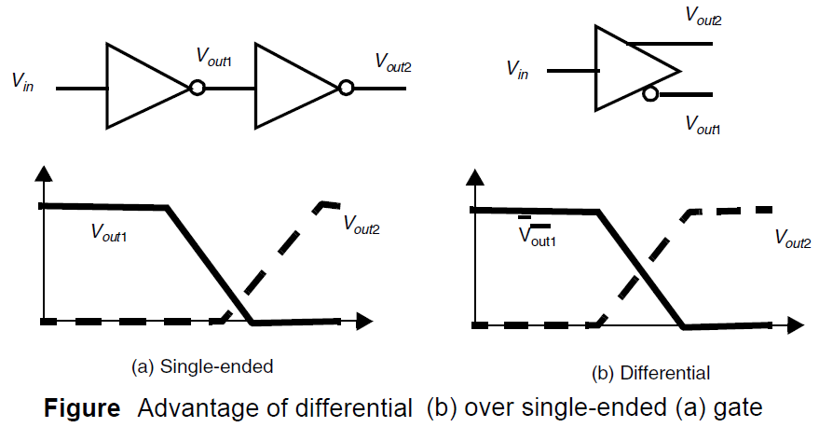
Design Consideration: Single-ended versus Differential
A distinct advantage in DCVSL, it eliminates the need for an extra inverter to produce the complementary signal. It has been observed that a differential implementation of a complex function may reduce the number of gates required. For example in some logic design it often happens that both a signal and its complement are needed simultaneously.
When the complementary signal is generated using an inverter, the inverted signal is delayed with respect to the original. This causes timing problems, especially in very high-speed designs. The differential output capability avoids this problem.

Slide 33
Continue….
With all these positive properties, why not always use differential logic?
Well, the differential nature virtually doubles the number of wires that has to be routed, leading very often to unwieldy designs (on top of the additional implementation overhead in the individual gates). Additionally, the dynamic power dissipation is high

Slide 34

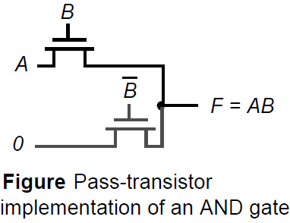
Pass Transistors Basics
A popular and widely-used alternative to complementary CMOS is pass-transistor logic, which attempts to reduce the number of transistors. The reduced number of devices has the additional advantage of lower capacitance.
An implementation of the AND function constructed that way, using only NMOS transistors. In this gate, if the B input is high, the top transistor is turned on and copies the input A to the output F. When B is low, the bottom pass transistor is turned on and passes a 0.
The switch driven by seems to be redundant at first glance. Its presence is essential to ensure that the gate is static, this is that a low-impedance path exists to the supply rails under all circumstances.
Consider the case when the pass transistor is charging up a node with the
gate and drain terminals set at V_{DD} . Let the source of the NMOS pass
transistor be labeled x. Node x will charge up to V_{DD}-V_{Tn}(V_{x}):.

Slide 35
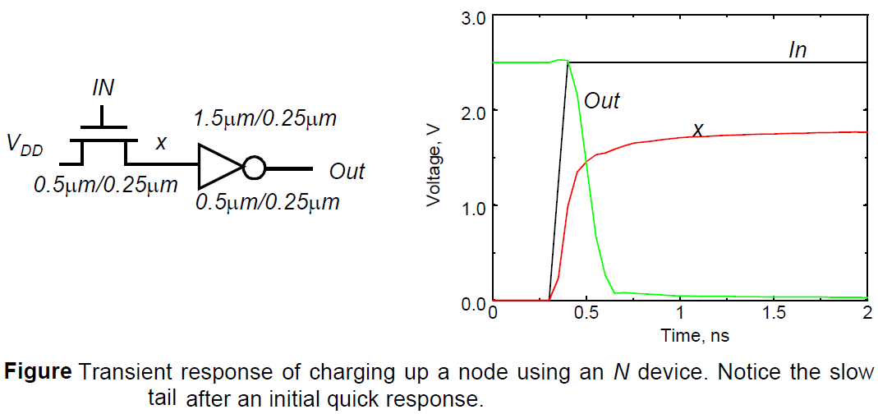
Continue….

Slide 36
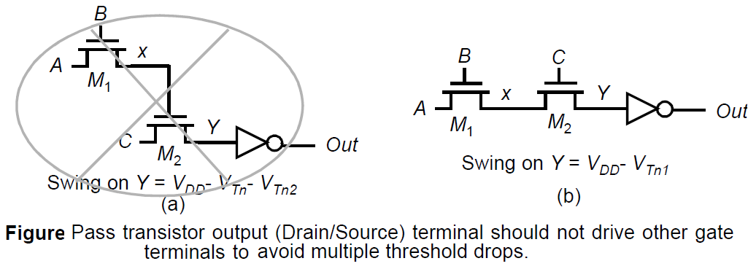
Continue…
The above example demonstrates that pass-transistor gates cannot be cascaded by connecting

Slide 37
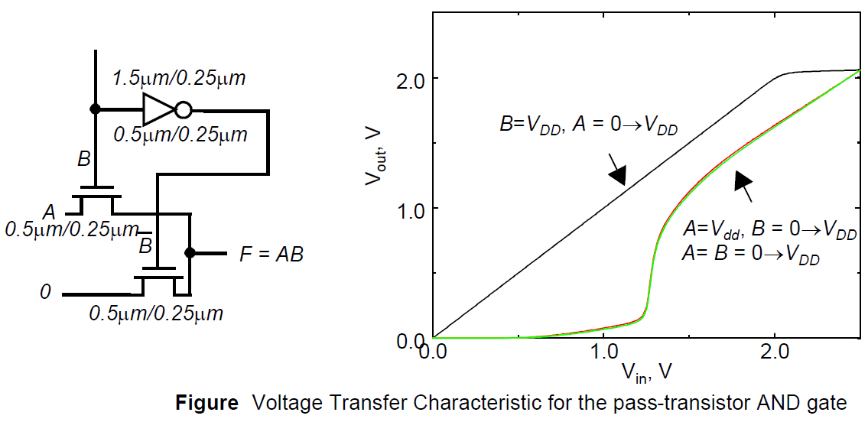
VTC of the pass transistor AND gate
Similar to complementary CMOS, the VTC of pass transistor logic is data-dependent.
For the case when B = V_{DD}, the top pass transistor is turned on, while the bottom one is turned off. In this case, the output just follows the input A until the input is high enough to turn off the top pass transistor ((i.e., reaches V_{DD}-V_{Tn}).
Next consider the case when A=V_{DD}, and B makes a transition from 0 1. the bottom pass transistor is turned on till then and the output is close to zero.
A similar behavior is
observed when both inputs
A and B transition
from 0 1.

Slide 38
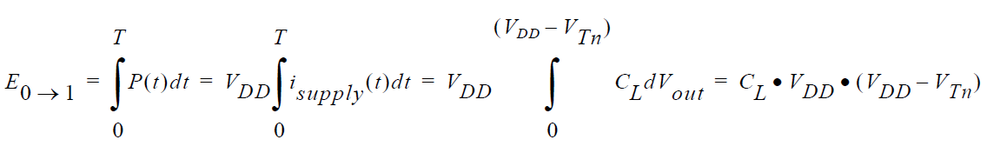
Continue…..
Pass-transistors require lower switching energy to charge up a node due to the reduced voltage swing.
For the pass transistor circuit in previous case assume that the drain voltage is at V_{DD} and the gate voltage transitions to V_{DD}.
The output node charges from 0V to V_{DD}-V_{Tn} (assuming that node x was initially at 0V). and the energy drawn from the power supply for charging the output of a pass transistor is given by:

Slide 39
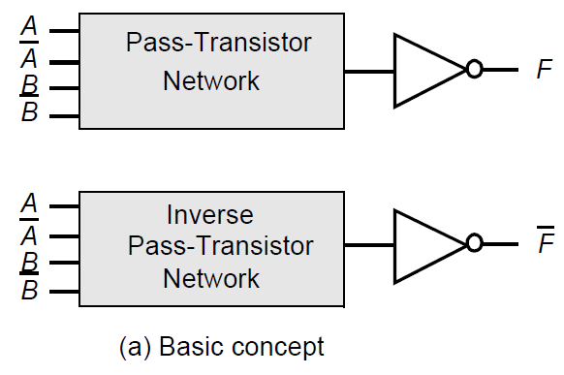
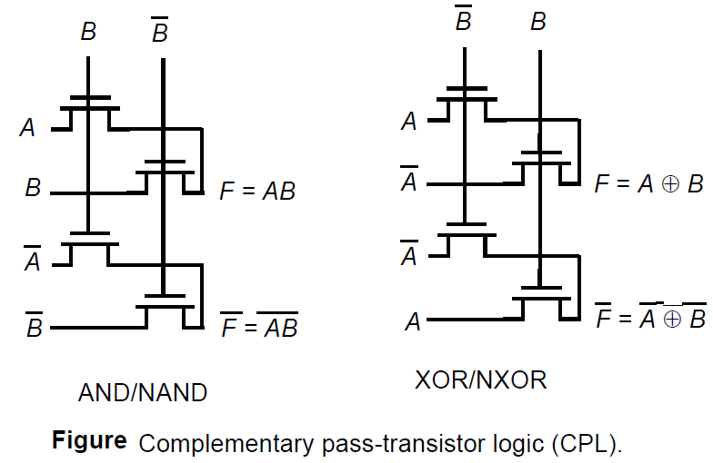
Differential Pass Transistor Logic
A differential pass-transistor logic family, called CPL or DPL, is commonly used. The basic idea (similar to DCVSL) is to accept true and complementary inputs and produce true and complementary outputs.
A number of CPL gates (AND/NAND and XOR/NXOR) are shown in Figure

Slide 40
Continue……
These gates possess a number of interesting properties -
Some complex gates such as XORs and adders can be realized efficiently with a small number of transistors. Furthermore, the availability of both polarities of every signal eliminates the need for extra inverters.
CPL belongs to the class of static gates, because the output-defining nodes are always connected to either VDD or GND through a low resistance path. This is advantageous for the noise resilience.
The design is very modular. In effect, all gates use exactly the same topology. Only the inputs are permutated. This makes the design of a library of gates very simple.

Slide 41
Robust and Efficient Pass-Transistor Design
Differential pass-transistor logic, like single-ended pass-transistor logic, suffers from static power dissipation and reduced noise margins. since the high input to the signal-restoring inverter only charges up to V_{DD}-V_{Tn}.
There are several solutions proposed to deal with this problem as outlined below.
Solution 1: Level Restoration
A common solution to the voltage drop problem is the use of a level restorer, which is a single PMOS configured in a feedback path.
If input A makes a 0 to V_{DD} transition, Mn only charges up node X to V_{DD}-V_{Tn}. This is, however, enough to switch the output of the inverter low, turning on the feedback device Mr and pulling node X all the way to V_{DD} .
This eliminates any static power dissipation in the inverter because voltage levels are either at GND or VDD, and no staticpower is consumed. This solution add one complexity since the
circuit is now ratioed

Slide 42
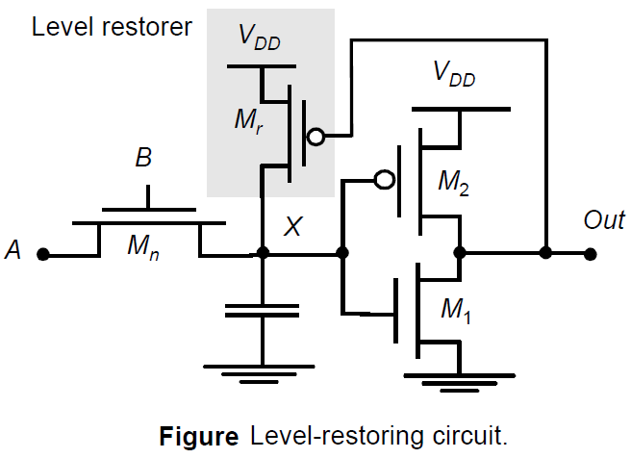
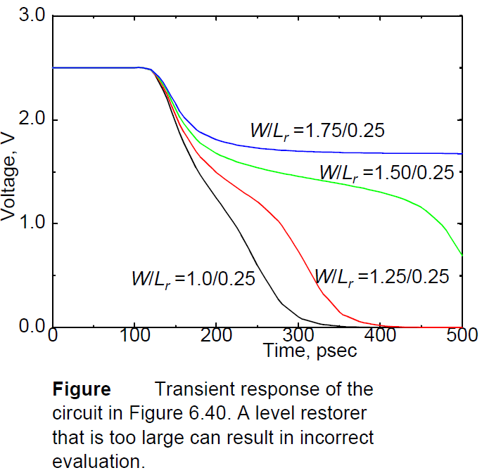
Continue…
If W/L ratio is large it will transfer the charge at faster rate. Furthermore it will store more value.

Slide 43
Continue…
We have consistently widened the PMOS transistor so that its resistance matches. The motivation behind this approach is to create an inverter with symmetrical VTC. However, this does not imply that this ratio also yields the minimum overall propagation delay.
If symmetry and noise margins are not of prime concern it is actually possible to speed up the inverter by reducing the width of the PMOS device.
This optimum ratio can be derived through the following simple analysis. Consider two identical, cascaded CMOS inverters. The load capacitance of the first gate equals approximately

Slide 44
Sizing of level restorer
The sizing of M_{r} and M_{n} will change the logic at point ‘x’ .
If M_{r} is stronger than M_{n} restoring at x is faster .
If M_{n} is stronger than M_{r} de-storing at x is an important issue.
Power dissipation is very small – no static power dissipation.
Another concern if delay of inverter is more then M_{r} transistor will take more time to restore.

Slide 45
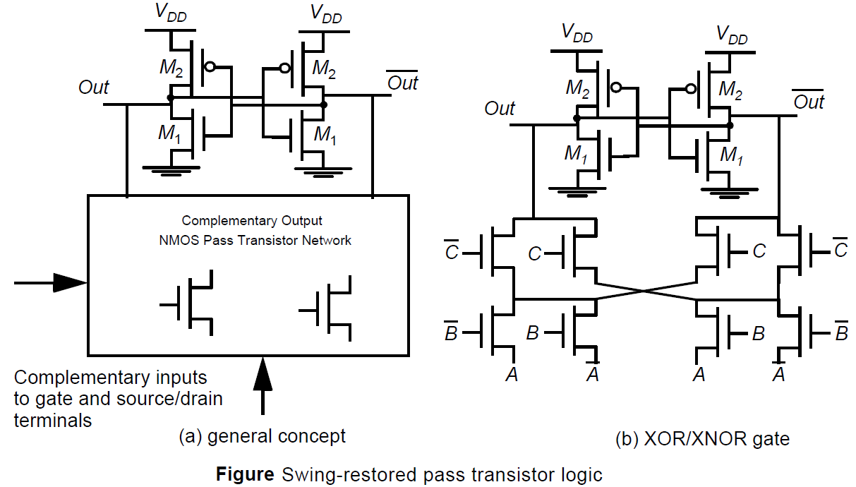
Swing-restored pass transistor logic
A modification of the level-restorer, applicable in differential networks and known as swing-restored pass transistor logic. Instead of a simple inverter or half-latch at the output of the pass transistor network, two back-to-back inverters, configured in a cross-coupled fashion, are used for level restoration and performance improvement.

Slide 46
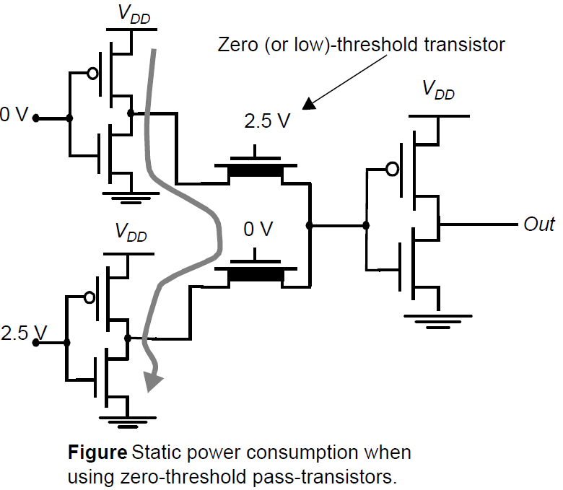
Multiple-Threshold Transistors
If we use zero threshold devices for the NMOS pass-transistors eliminates most of the threshold drop, and passes a signal close to V_{DD}.
The use of multiple-threshold transistors is becoming more common, and involves simple modifications to existing process flows.
The use of zero-threshold transistors can be dangerous
due to the subthreshold currents that can flow through
the pass-transistors, even if VGS is slightly below V_{T}.

Slide 47

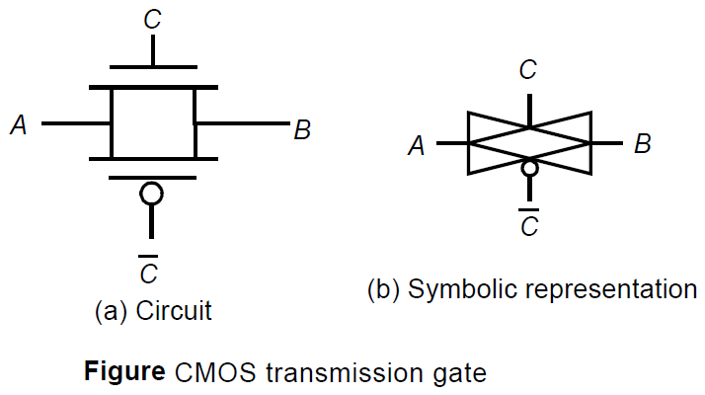
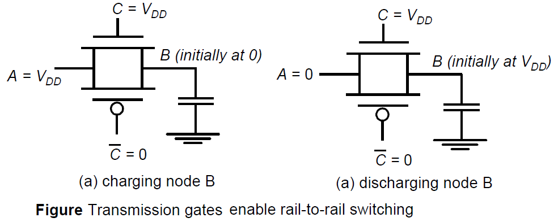
Transmission Gate Logic
The most widely-used solution to deal with the voltage-drop problem is the use of transmission gates.
The transmission gate combines the best of both device flavors by placing a NMOS device in parallel with a PMOS device.
The transmission gate acts as a bidirectional switch controlled by the gate signal C. In short

Slide 48

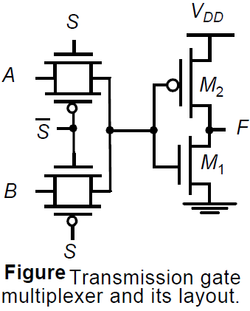
Continue……
Transmission gates can be used to build some complex gates very efficiently . The gate either selects input A or B based on the value of the control signal S, which is equivalent to implementing the following Boolean function.
A complementary implementation of the gate requires eight
transistors instead of six

Slide 49


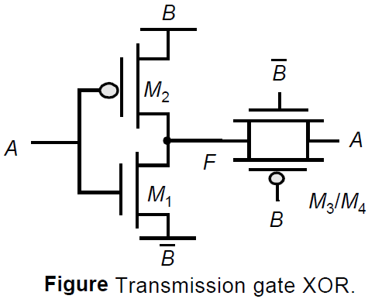
Continue……
Another example of the effective use of transmission gates is the popular XOR circuit.
To understand the operation of this circuit, we have to analyze the B = 0 and B = 1 cases separately.
For B = 1, transistors M1 and M2 act as an inverter while the transmission gate M3/M4 is off; hence F =
In the opposite case, M1 and M2 are disabled, and the transmission gate is operational, or F = The combination of both results in the XOR function.

Slide 50
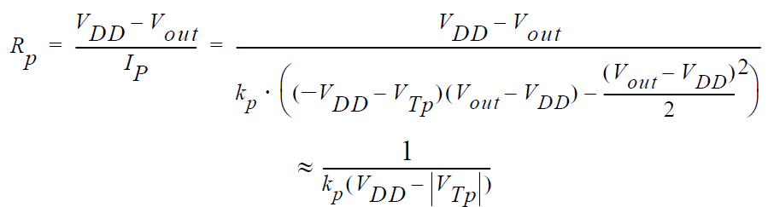
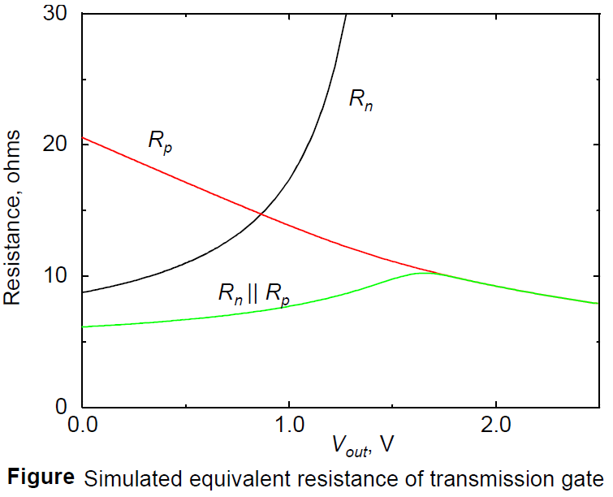
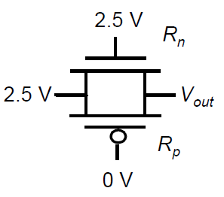
Performance of Pass-Transistor and Transmission Gate Logic
The pass-transistor and the transmission gate are, unfortunately, not ideal switches, and have a series resistance associated with it.
The effective resistance is modeled as a parallel connection of R_{n} and R_{p}.

Slide 51
Thank You

